Slide 1

Zero-Shot Image Captioning: A Revolution in Language
Unlocking the power of language to describe images across any language, without training on specific images.

Slide 2
Unleashing the Power of Zero-Shot Captioning
Unseen Images
Multilingual Support
Generate captions for images the model has never encountered before.
Choose any language you want and generate captions that are fluent and accurate.

Slide 3

A User-Friendly Experience
Easy to Use
Global Reach
No technical barriers or language restrictions. Anyone can easily use it.
Break down language barriers and empower a wider audience.

Slide 4
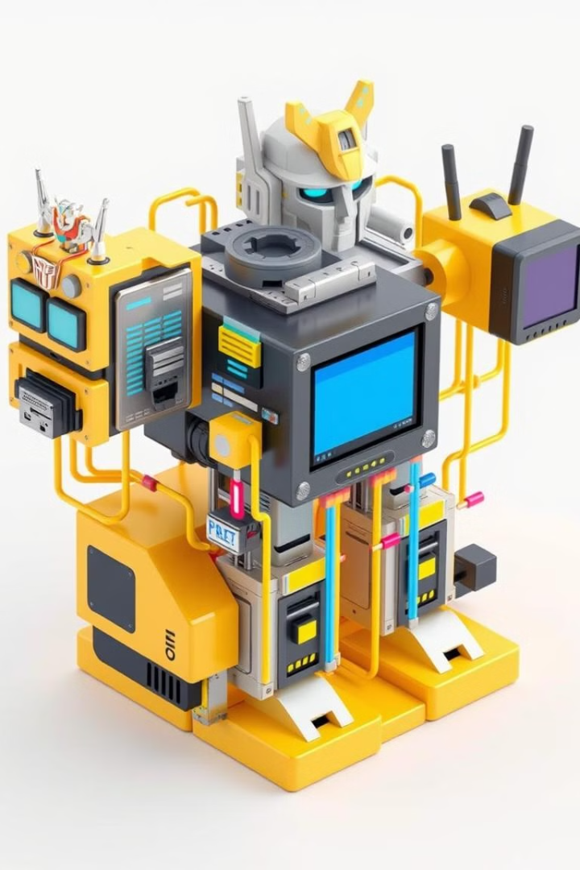



Behind the Scenes: Powering the Technology
Transformers
Robust models that excel in understanding and generating natural language.
CLIP
Bridging the gap between text and images, it aligns visual and linguistic representations.
BERT
Deeply understanding language context, it provides semantic richness for image descriptions.

Slide 5
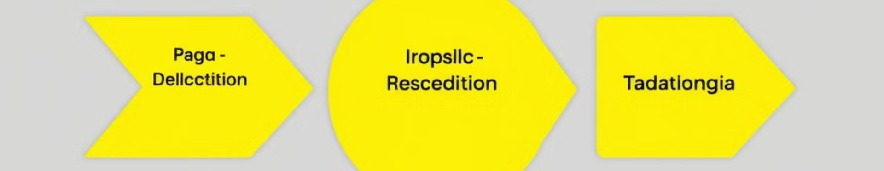



The Process: From Image to Caption
Upload Image
Specify Language
Generate Caption
Provide the image you want to caption.
Choose a language or provide a reference sentence.
The system generates a descriptive caption in the chosen language.

Slide 6
Getting Started: Setup and Installation
Clone Repository
1
Get the project code by cloning it.
Install Dependencies
2
Make sure you have Python and the necessary libraries.
Run the Code
3
Execute the provided Colab Notebook or Python script.

Slide 7
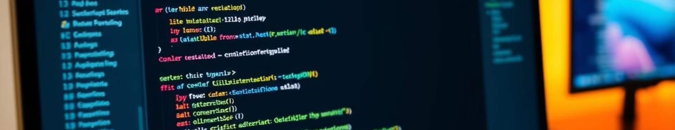
Ready to Try It Out?
Explore the possibilities and see how language can unlock new ways of understanding images. https://colab.research.google.com/drive/1LoDSWYE4QiASh0xgFEV7Ag8LlGtXxes5?usp=sharing

Slide 8
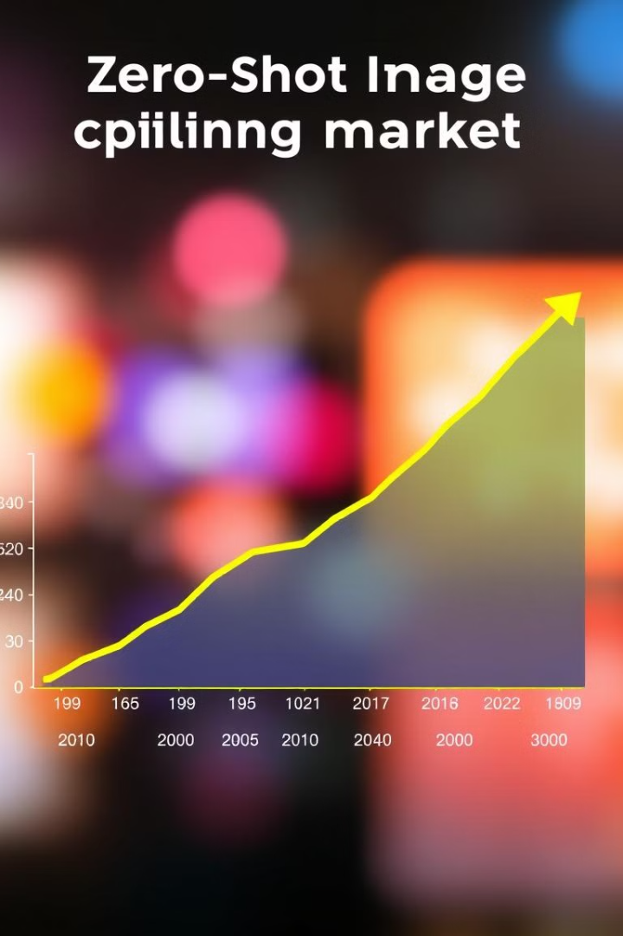
Key Takeaways and Next Steps
This project empowers developers and researchers with a groundbreaking technology for language-independent image understanding. Join us in exploring the vast potential of zero-shot captioning.

